Slide 1
Relational Algebra

Slide 2
Basic concepts
Domain: There are set of permitted values for every attribute, called its domain.
Exp- Domain of roll number{10,11,23,56,78}
Domain of branch{CSE,IT,ME,ECE}
Tuple: Each row in a relation is called tuple.
Relation: Collection of homogeneous tuples.
Degree or Arity: Number of attributes in relation R.
Cardinality: Number of tuples in relation R.

Slide 3
Keys:
Compatibility of Relations: Relations R and S are said to be compatible if
Both have same number of attributes.(same arity)
And domain on ith attribute of R must be same as of ith attribute of relation S.

Slide 4
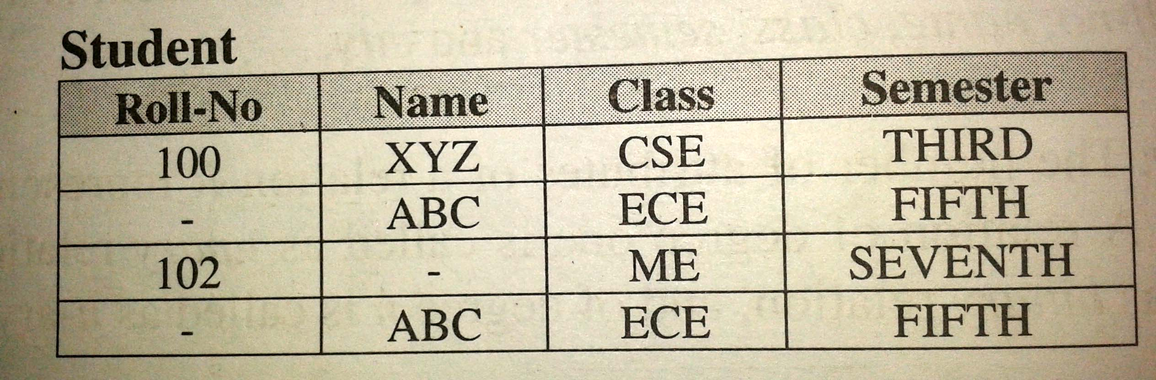
Integrity Rules
Rule 01
Entity integrity
If an attribute A of relation R is selected as primary key then it cannot accept null values.

Slide 5
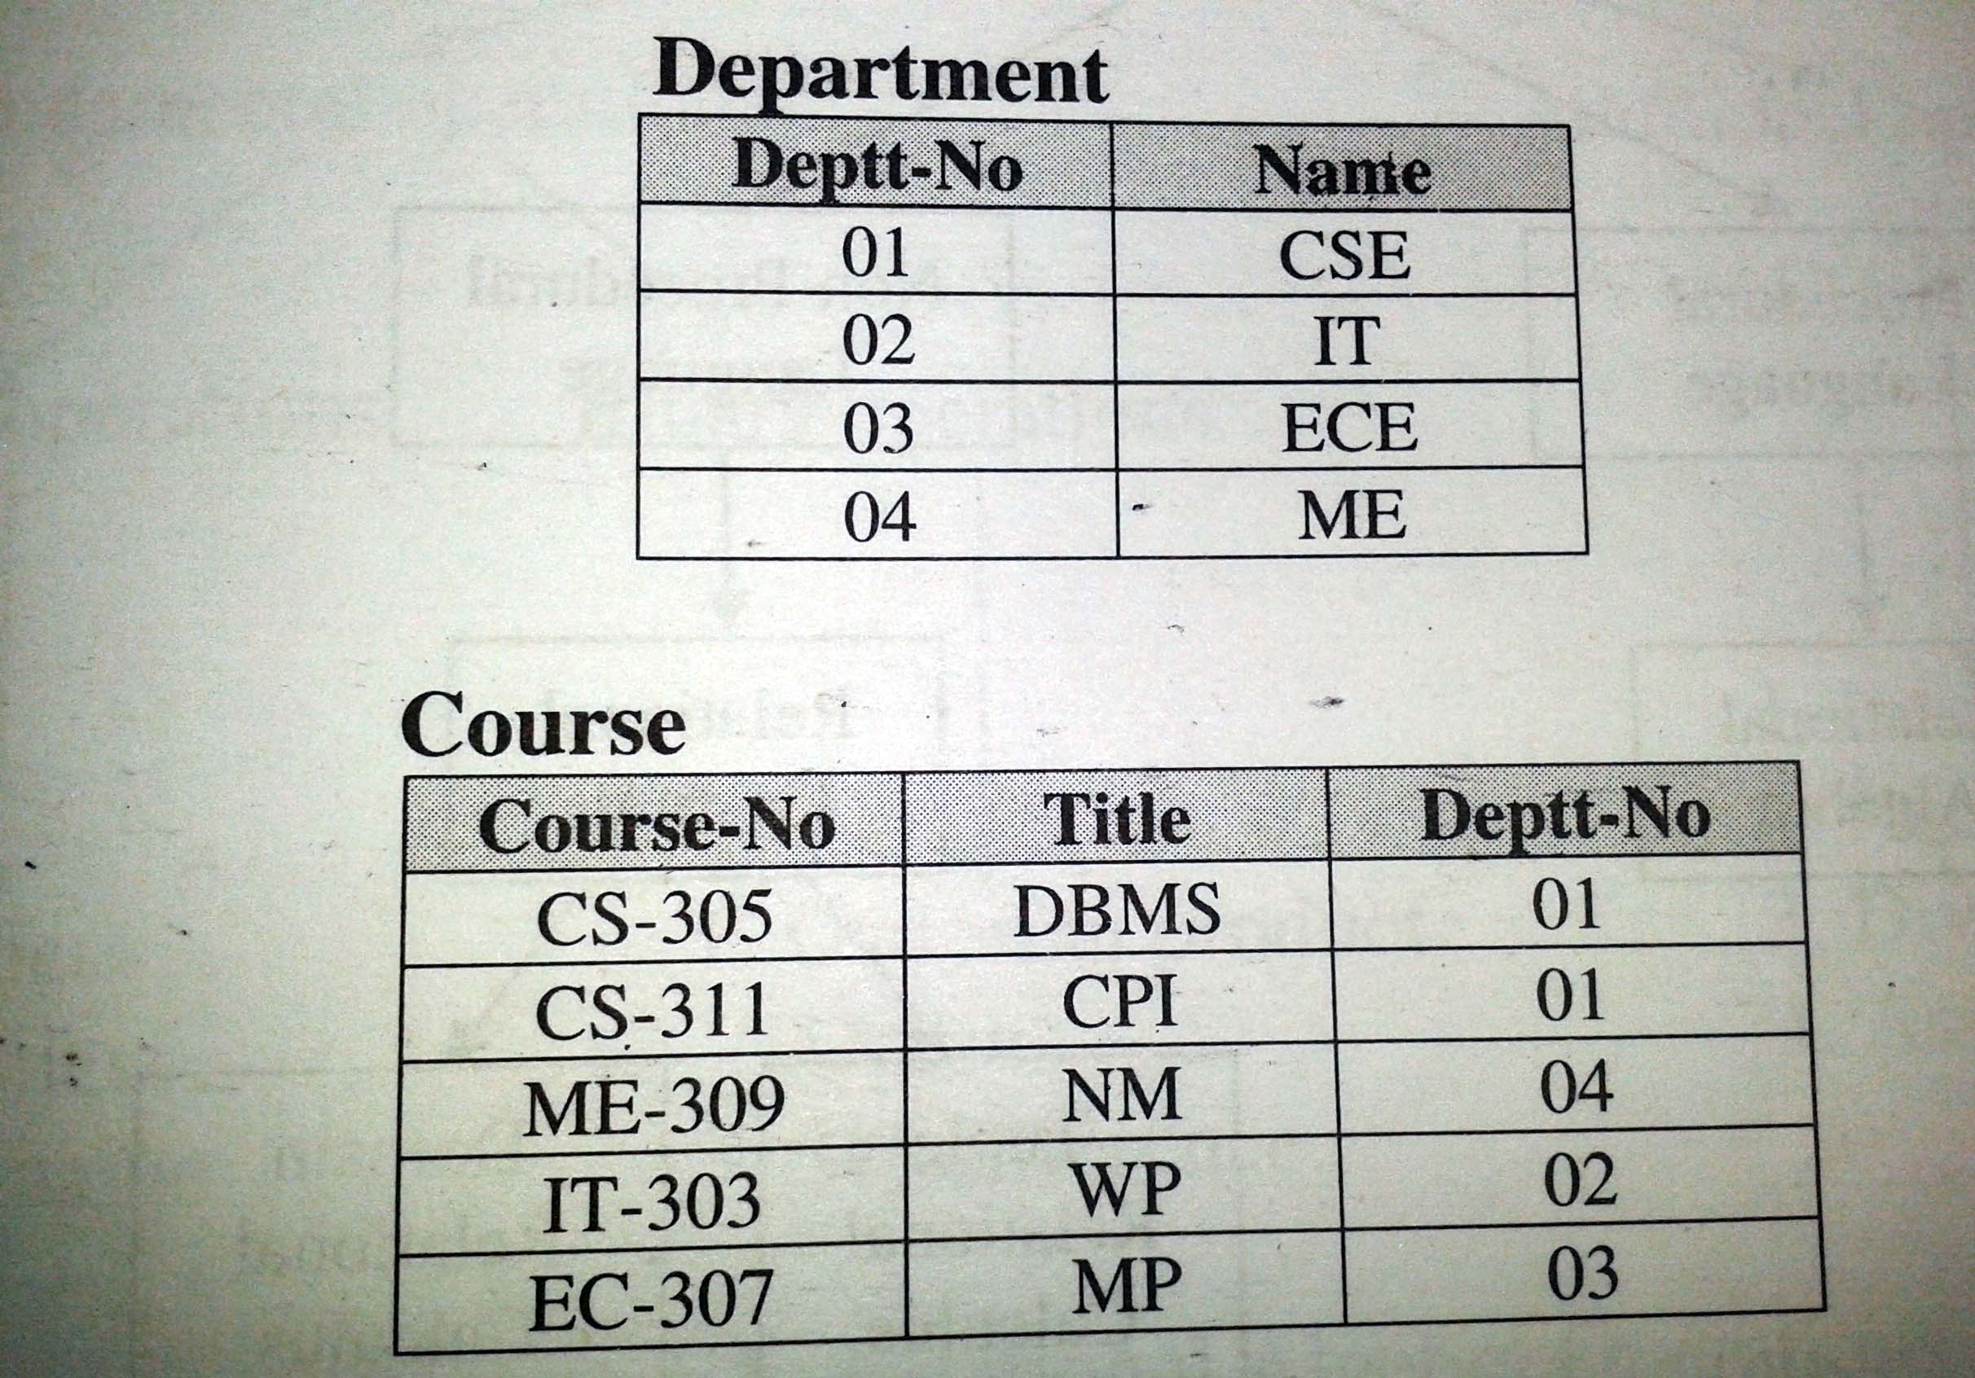
Rule 02
Referential Integrity

Slide 6
Query Language
Interface between the user and the data base.
A query Is a statement written in query language for retrieval od data from database.

Slide 7
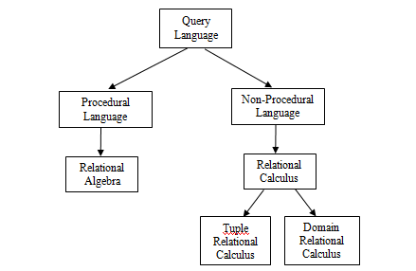

Slide 8
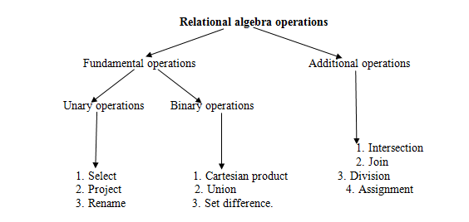
INTRODUCTION

Slide 9

Select
Select
Select operation selects the rows that satisfy a given predicate (condition).
The Greek letter sigma is used to denote the select operation.
Syntax:

Slide 10
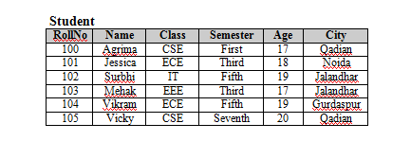
Find the students from the student relation who belong to qadian CITY.

Slide 11
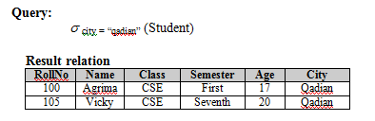

Slide 12
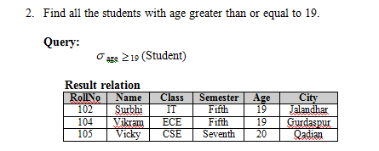

Slide 13

Project
Use to select attributes from the relation

Slide 14
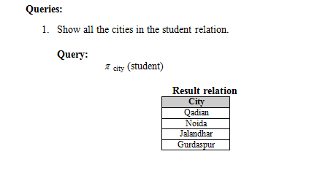

Slide 15
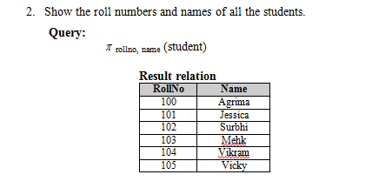

Slide 16
Rename
Used for following
1. When we want to change the name of any existing relation
2. When we want to give a name to a new relation which is obtained as a result of any relational algebra expression

Slide 18
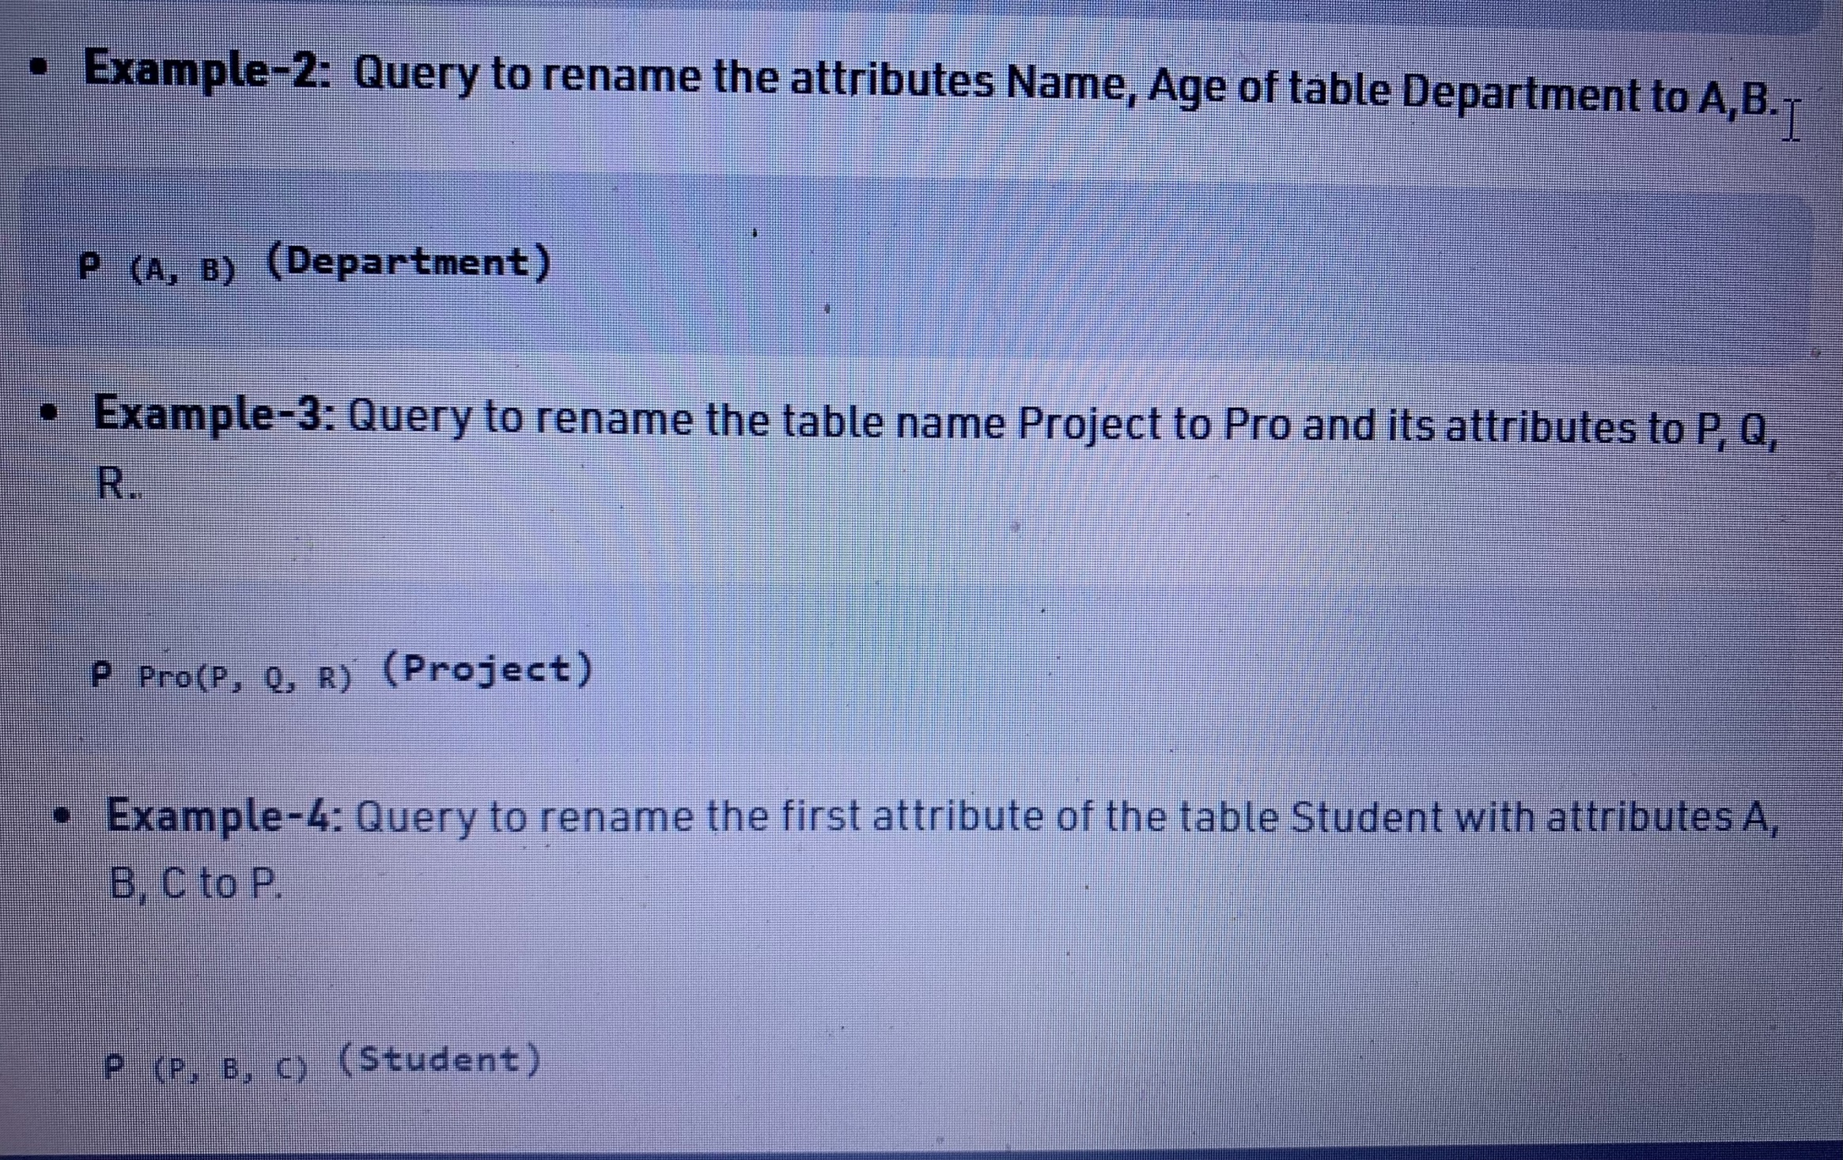

Slide 19
Cartesian Product
Cartesian product is denoted by cross (×) and it combines the information from any two relations.
Cartesian product of two relations R and S is denoted as R×S, which result in a new relation that contains all the possible combinations of tuples in R and S.

Slide 20
Degree or arity (P) = arity(R) + arity(S)
Cardinality (P) = cardinality(R) * cardinality(S)

Slide 21
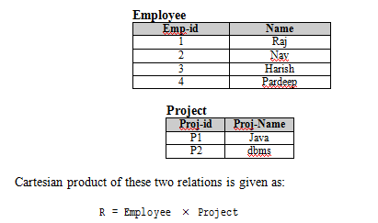

Slide 22
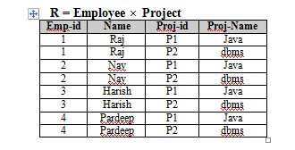

Slide 23

Union
the union of two sets results in a new set that contains all the elements belonging to both the sets but does not include the duplicate elements

Slide 24
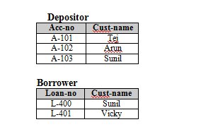


Slide 25
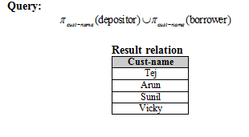

Slide 26

Set Difference
the difference of two sets results in a new set that contains all the elements of first set which are not present in the second set.

Slide 27
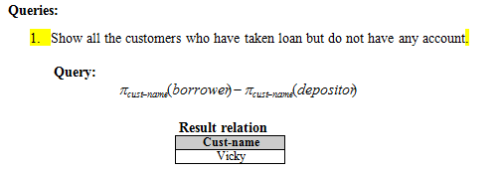

Slide 28

Intersection
Intersection of two sets results in a new set which contains the common elements from both the sets.

Slide 29
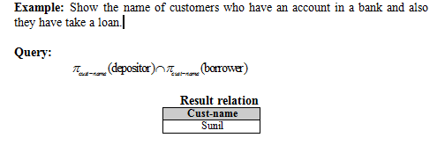

Slide 30
Natural Join
Join operation allows us to combine certain selections and cartesian product into one operation.

Slide 31
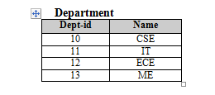
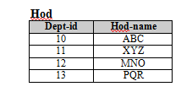
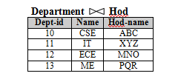

Slide 32

Example: Show all the customers who have an account and also have taken a loan.

Slide 33
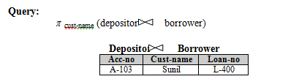


Slide 34
Outer Join
Outer-join operation is an extension of natural join which deals with missing information.

Slide 35
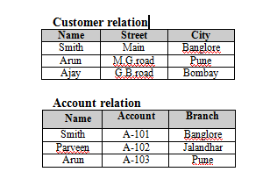


Slide 36
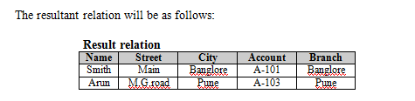

Slide 37
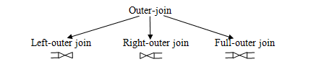

Slide 38
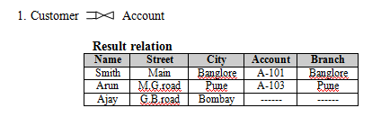

Slide 39
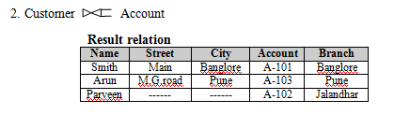

Slide 40
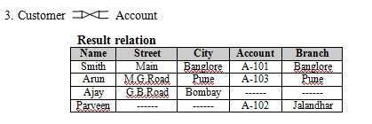

Slide 41
Division
The division operation is suited to the queries that include the phrase “for all”.

Slide 42
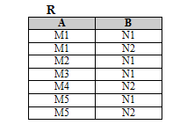


Slide 43
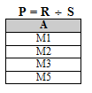

Slide 44
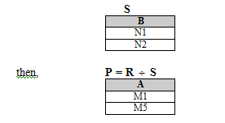

Slide 45
